Slide 1
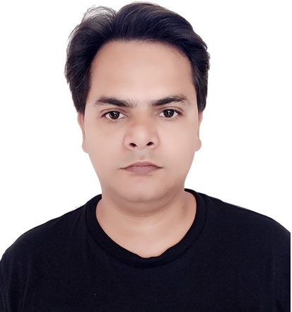
RAM PRAKASH SINGH – Architect & Lead
BACKGROUND
RELEVANT EXPERIENCE
11+ years of experience in all aspects of software development, from extensive analysis and design through execution and maintenance in various business domains. Experienced in managing, leading development & integration projects, domain driven design, test driven development, product development.
Experienced in microservices, monolithic, Java, Reactive programming, AWS, Docker, Redis, open-source technologies such as spring/spring boot/Spring Web Flux, Hibernate, JPA, application servers, version control, build and deployment tools, SQL/NO-SQL databases.
Responsibilities- Map the business requirement to the technical solution. Maintain and develop API contracts. Responsible for creating low-level design documents such as architecture diagrams, and sequence diagrams for the features to be developed. Coordinate with stakeholders on the information required for the implementation of technical solutions. Support team on technical queries and issues, code reviews.
Commerce Next Adidas (AFNT)
Tech arch delivery lead for Ecommerce microservice based application for scrum team. Adidas Commerce Next is an initiative, leveraging lightweight microservices architecture to develop the ecosystem of domain-driven microservices. Tech stack: Java, SpringBoot, SpringWebflux, PostgreSQL, Docker, K8S, Junit, Maven, Redis, Akamai, Grafana with Prometheus, Sonar, AWS, Kibana..
Business On Line (Corporate banking) – Bank Of Ireland Client. Location: Ireland.
Tech lead for Corporate Banking web application for scrum team. Agile software develoment methodology. Tech stack such as Java, Spring,Oracle, Coolgen, Mainframe, Kafka, ELK etc.
Machine to Machine – Yanmar Agriculture Equipment Client . Location: Japan & India.
Tech arch delivery lead for Cloud based application for scrum team. Agile software development methodology. Tech stack Java, AWS(IOT, Kinesis, Lambda, EC2, S3, DynamoDB), Docker etc.
Socrates - Specsaver Optical Group Ltd Client. Location UK, Australia, Nederland
Part of Product development scrum team, Tech stack such as Java, Spring, Hibernate, SOAP WS SQL database.
TECHNICAL SKILL SET
Java AWS JPA
SpringBoot Container Docker/K8S SQL./No-SQL
Spring WebFlux Redis Junit
REST Hibernate Graphana
Microservice Swagger
INDUSTRY EXPERIENCE
Ecommerce
Banking
Retail
Manufacturing(AWS IOT)

